Slide 1
Use of computational methods for logical modelling of biological networks deregulated in diseases
A Montagud, P Traynard, L Martignetti, E Bonnet, E Barillot, A Zinovyev, L Calzone
Briefings in Bioinformatics, bbx163
DOI: 10.1093/bib/bbx163

Slide 2
Pipeline of methods outline
Simulation of Boolean model
Analysing the network
Analysing stable solutions
Principal component analysis
Displaying asymptotic solutions
Predicting genetic interactions of mutants
Robustness analysis of genetic interactions with respect to the phenotype probability
Robustness analysis of logical gates
Robustness analysis of logical gates with respect to the phenotype probability
Robustness analysis of logical gates with respect to the stable states

Slide 3
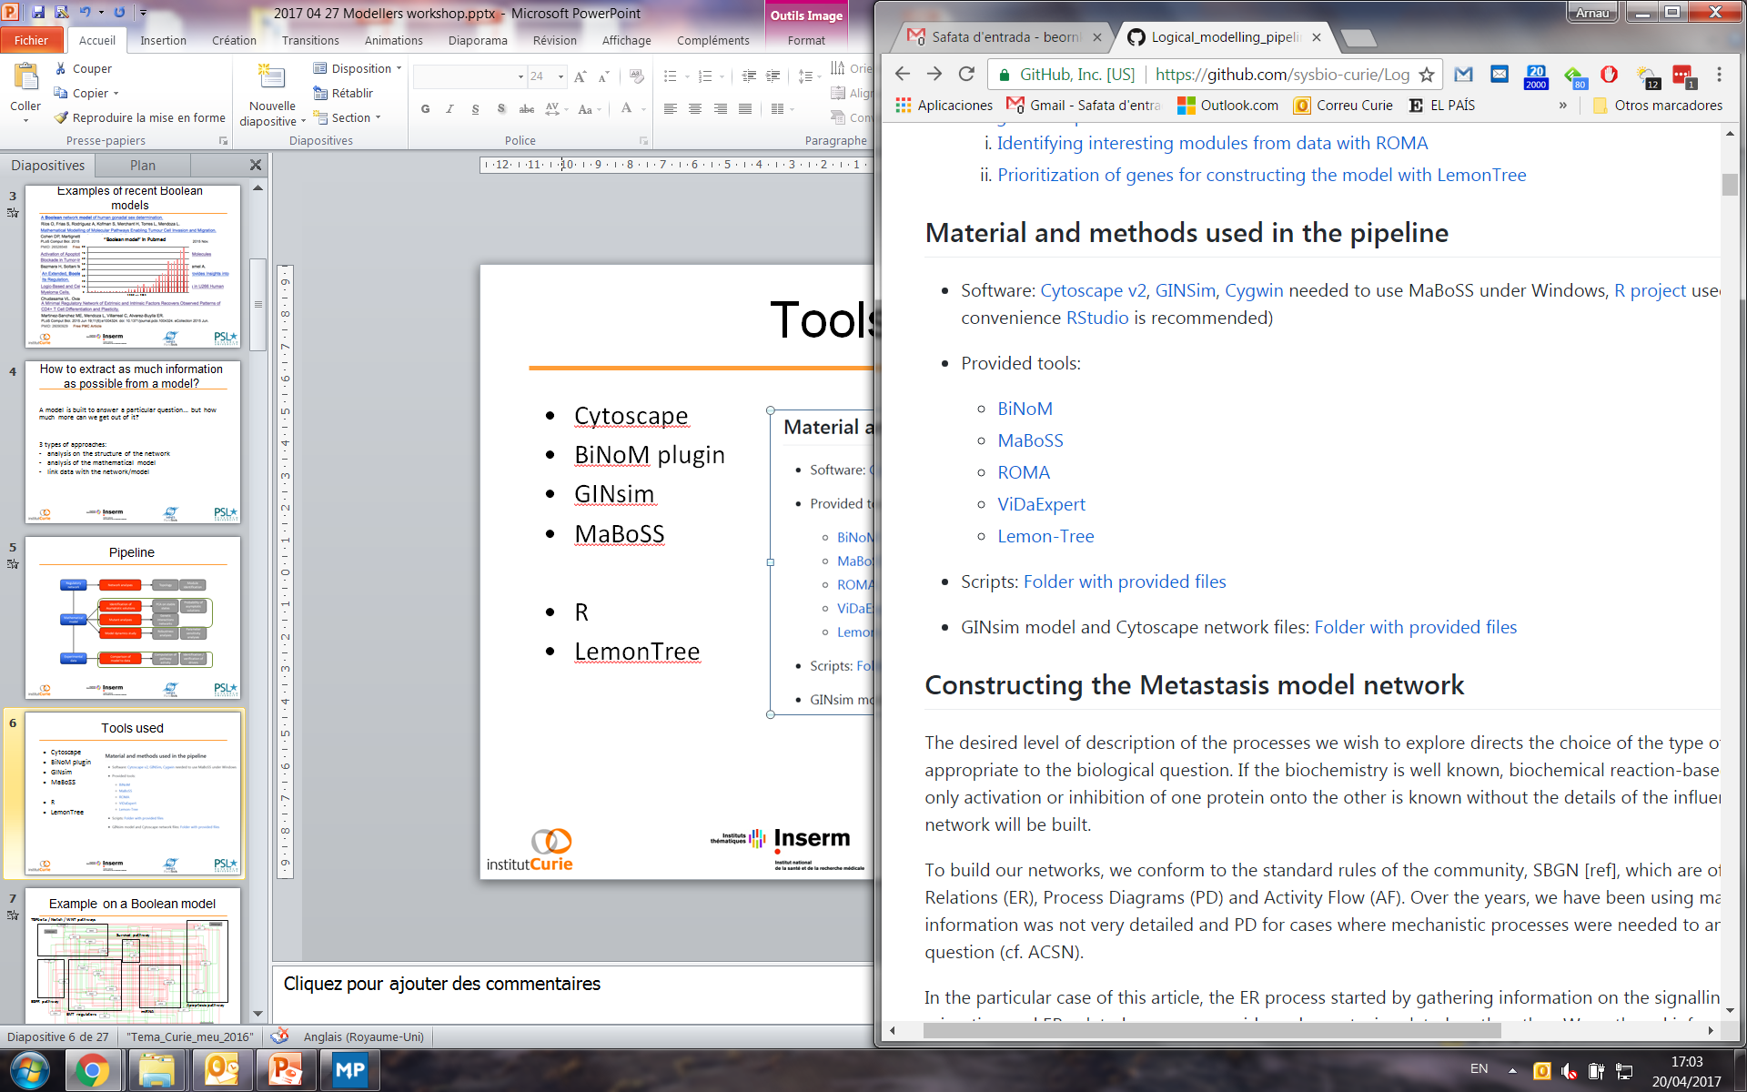
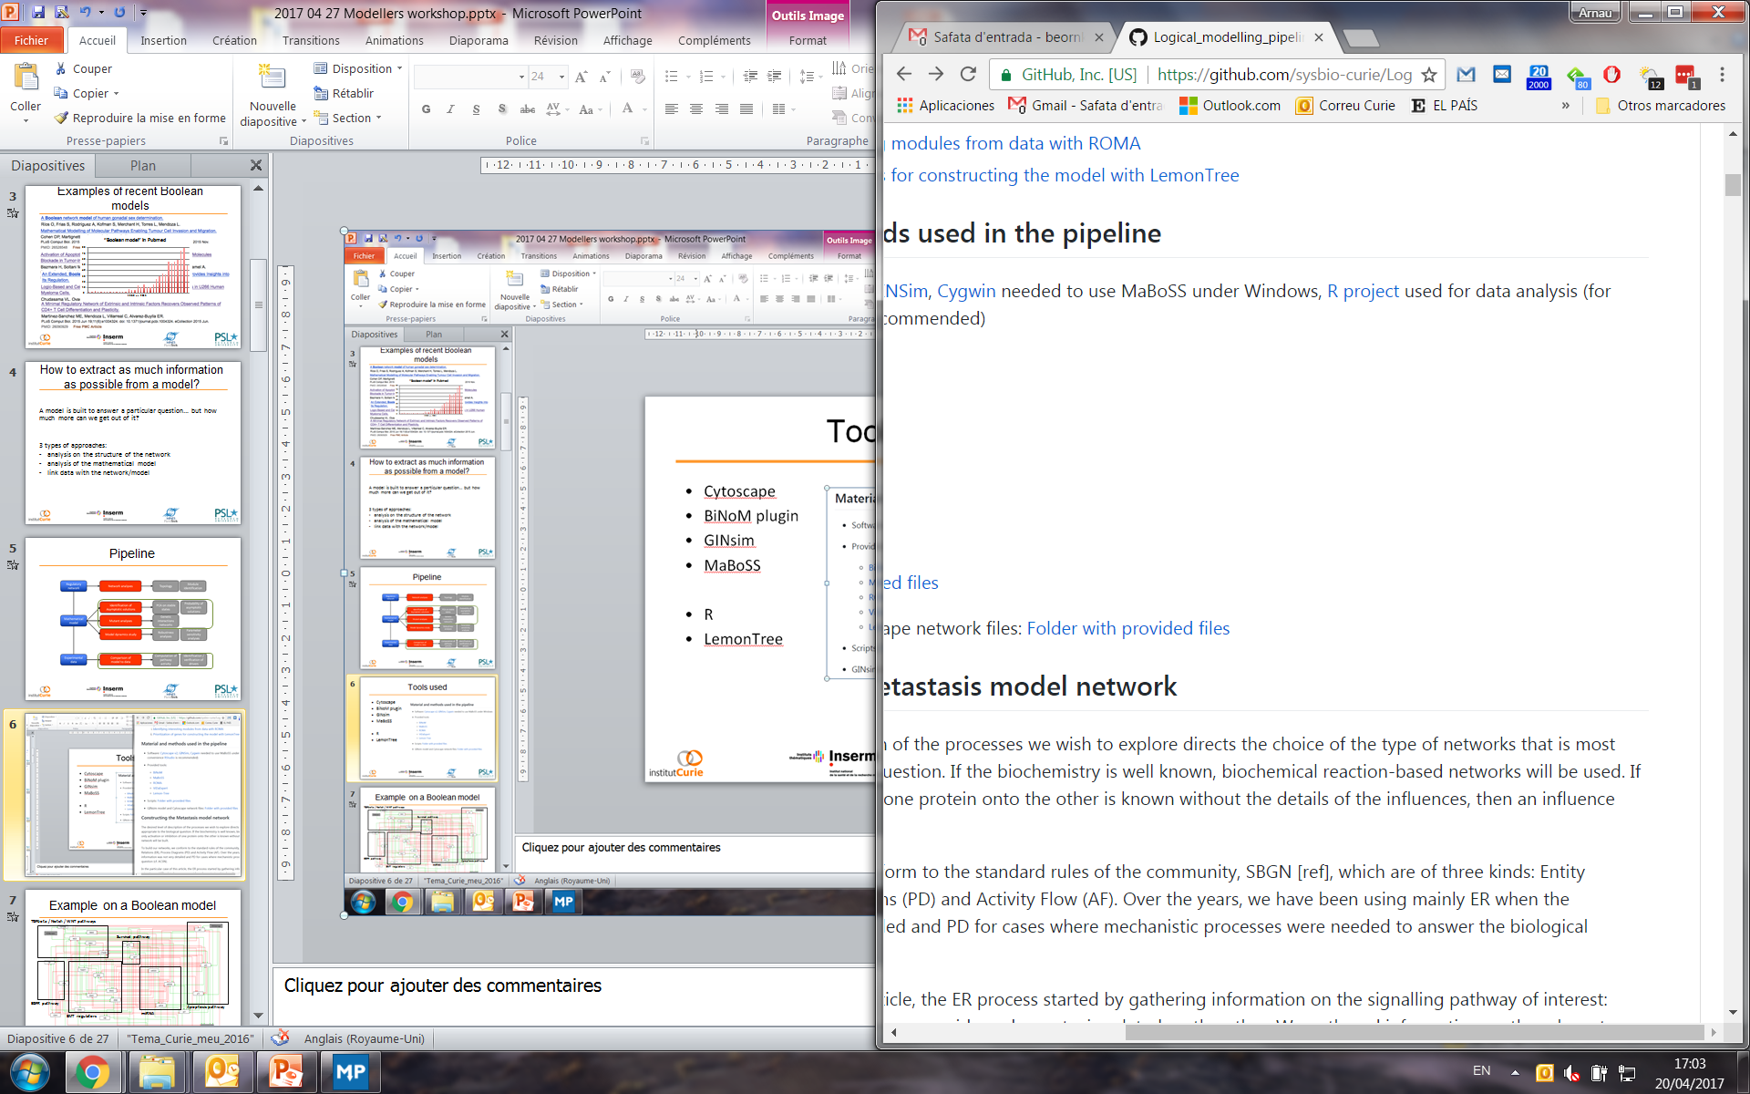
Tools used
https://github.com/sysbio-curie/Logical_modelling_pipeline
From others
From our group

Slide 4
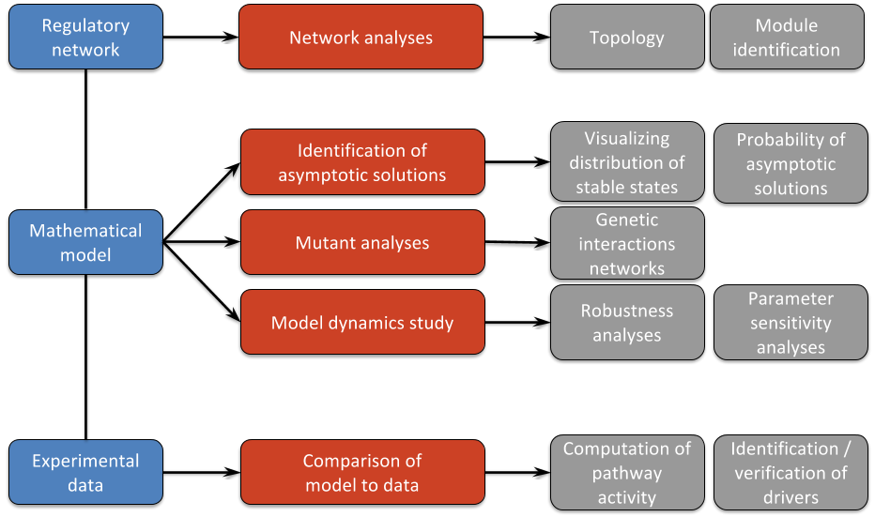
Pipeline

Slide 5
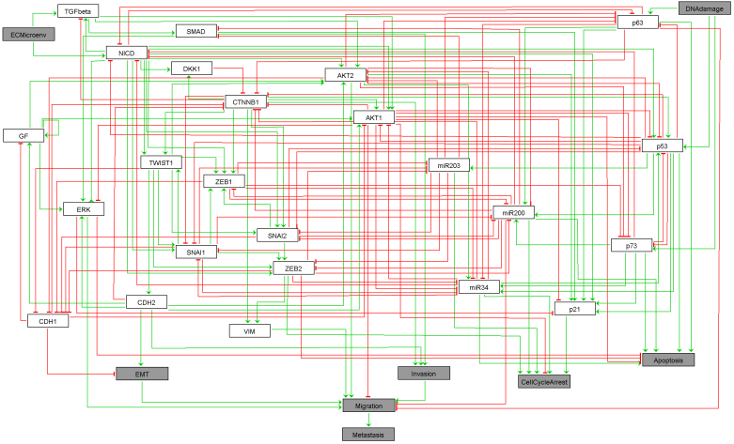
Example on a Boolean model
TGFbeta / Notch / WNT pathways
Survival pathway
EGFR pathway
Apoptosis pathway
miRNA
EMT regulators
Cohen et al. (2015) PLoS Comp Biol

Slide 6

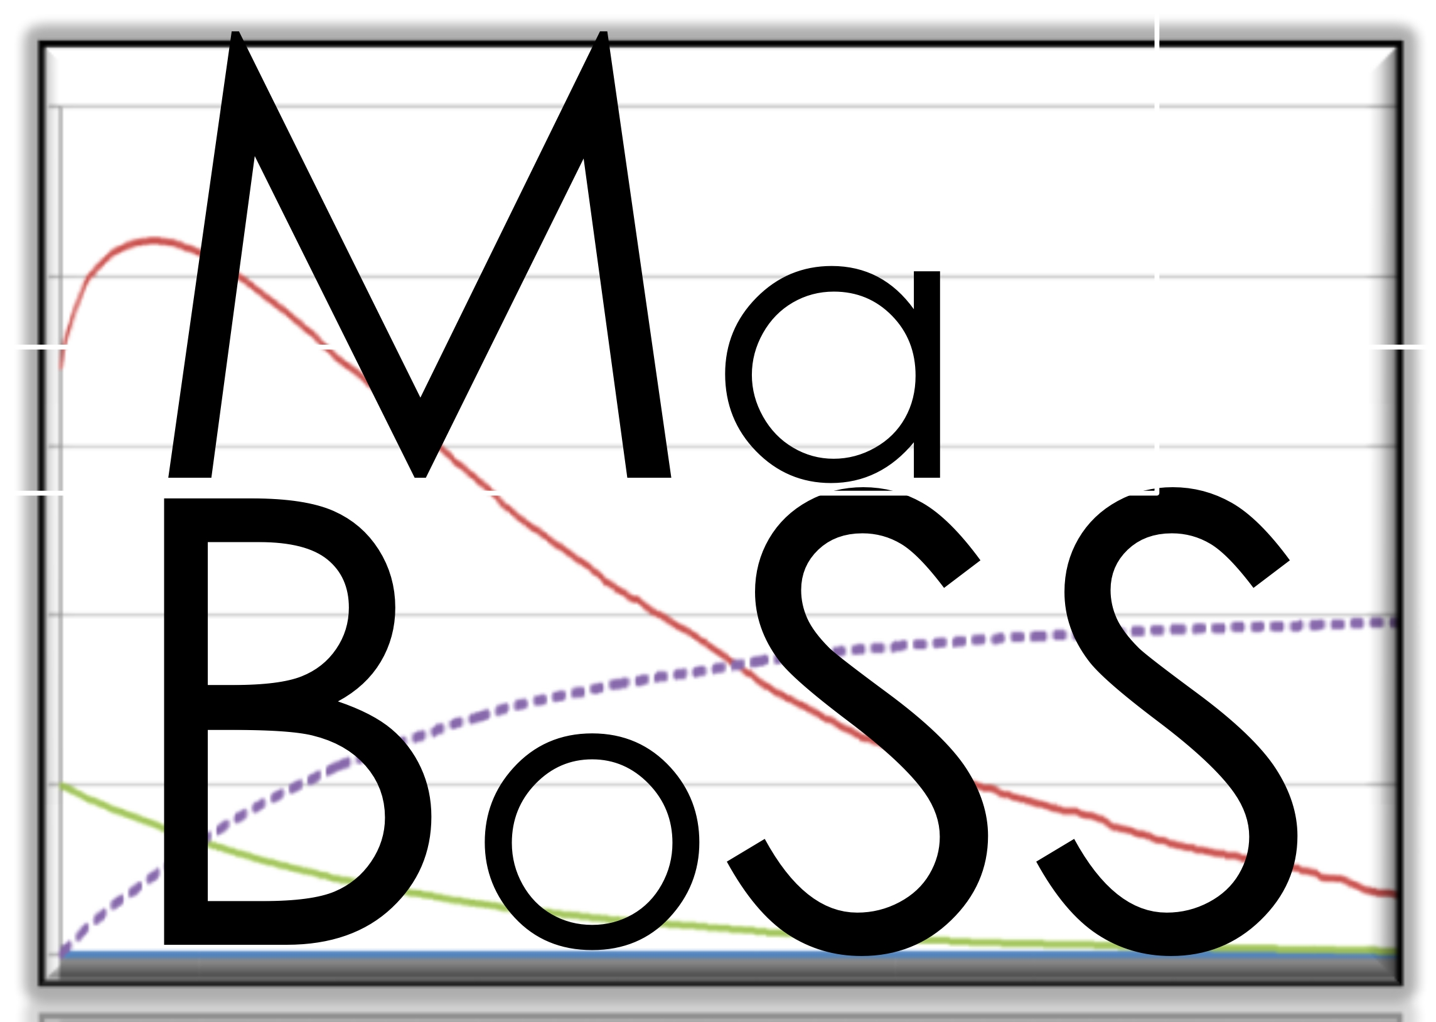
Tools used for Boolean simulations
GINsim (Gene Interaction Network simulation) is a computer tool for the modeling and simulation of genetic regulatory networks.
MaBoSS is a C++ software for simulating continuous/discrete time Markov processes, applied on a Boolean network.
www.ginsim.org
maboss.curie.fr
Chaouiya C, Naldi A, Thieffry D. 2012. Logical Modelling of Gene Regulatory Networks with GINsim.. Methods in molecular biology (Clifton, N.J.). 804:463-79.
Stoll G, Viara E, Barillot E, Calzone L. Continuous time Boolean modeling for biological signaling: application of Gillespie algorithm. BMC Syst Biol. 2012 Aug 29;6:116.

Slide 7
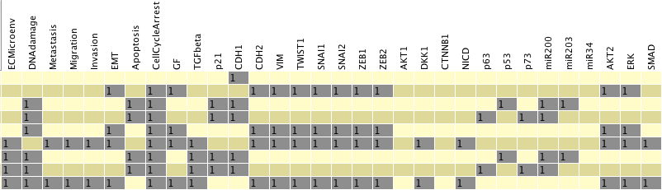
Boolean model results
Stable states table
Each stable state corresponds to a biological situation/context
Inputs are set
Mechanisms are known
Objectives are stable states
Once stable states are clear
Perturbing the mechanisms is highly informative
Overexpression /Knock out
Inputs
Outputs
Notes:
… and we can also use this matrix as a source of PCA

Slide 8
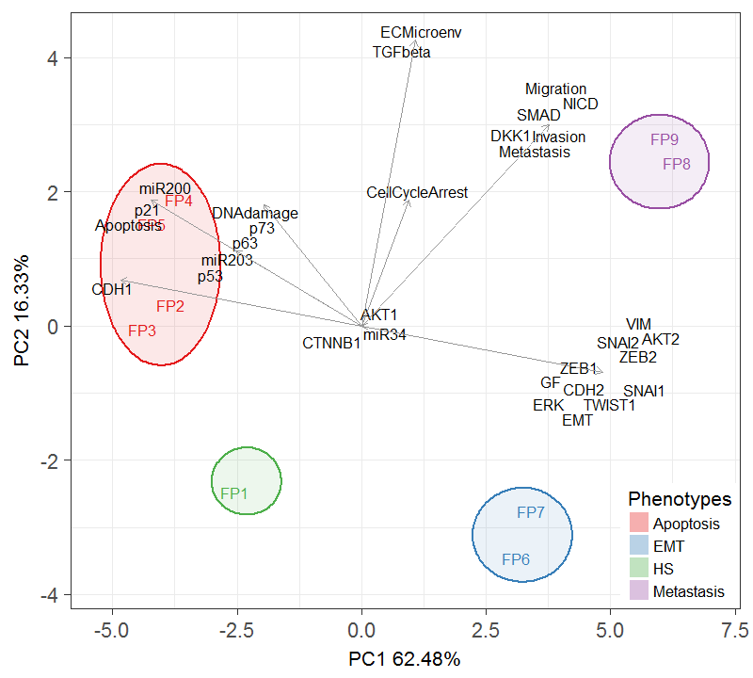
We can classify the solutions of the Boolean model using PCA

Slide 9
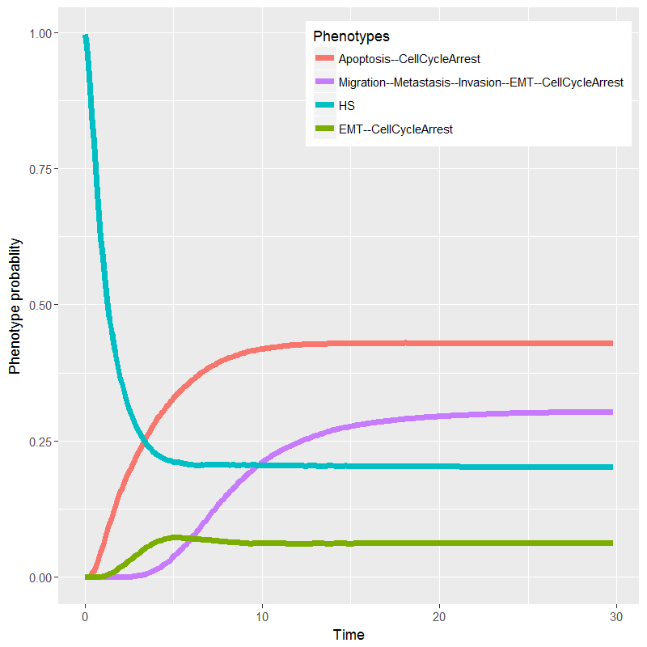
Asymptotic solutions
Stable state solutions, where the system can no longer evolve
Probabilities of reaching a state from an initial condition
Method:
continuous time Markov process / Gillespie algorithm
a rate of change associated to each transition (separate rate up and rate down)
To each Boolean state, a probability is associated
http://www.ginsim.org
https://maboss.curie.fr
Notes:
Time variations
Similar to robustness analysis of dynamic systems
Transient effects can be seen
Population heterogeneity
Mutants can be studied semi-quantitatively

Slide 10
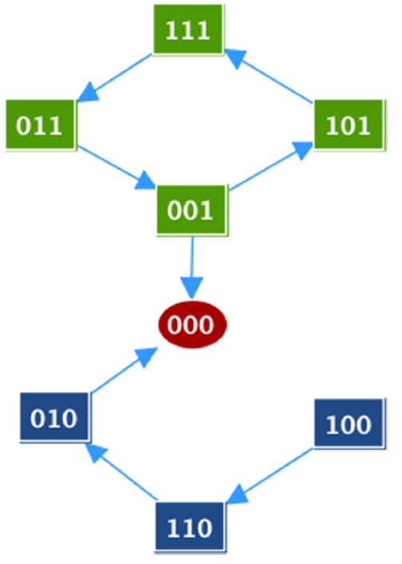
Analysing stable states: MaBoSS
Gillespie algorithm on the Boolean transition state space
Each Boolean state has an associated probability
Rate of change associated to each transition
rate up and rate down
Stochasticity, time, probabilities, …
Perturbations can be studied in a probabilistic manner
Transient effects, such as Knock downs
Dosage experiments
Software developed by Stoll et al, BMC Systems Biology 2012
DOI: 10.1186/1752-0509-6-116
MaBoSS 2.0: DOI: 10.1093/bioinformatics/btx123
k_up
k_down

Slide 11
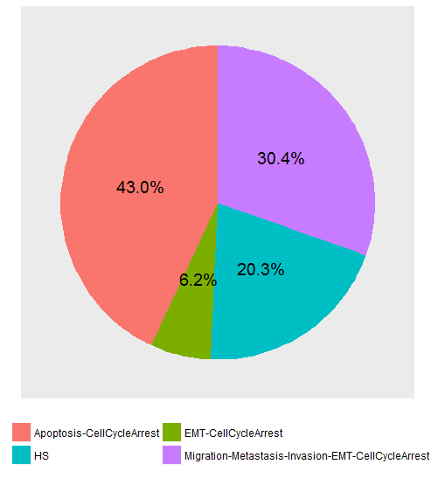
MaBoSS solutions of the Boolean model can be interpreted biologically
Time variations
Similar to robustness analysis of dynamic systems
Transient effects can be seen
Population heterogeneity
Mutants can be studied semi-quantitatively

Slide 12
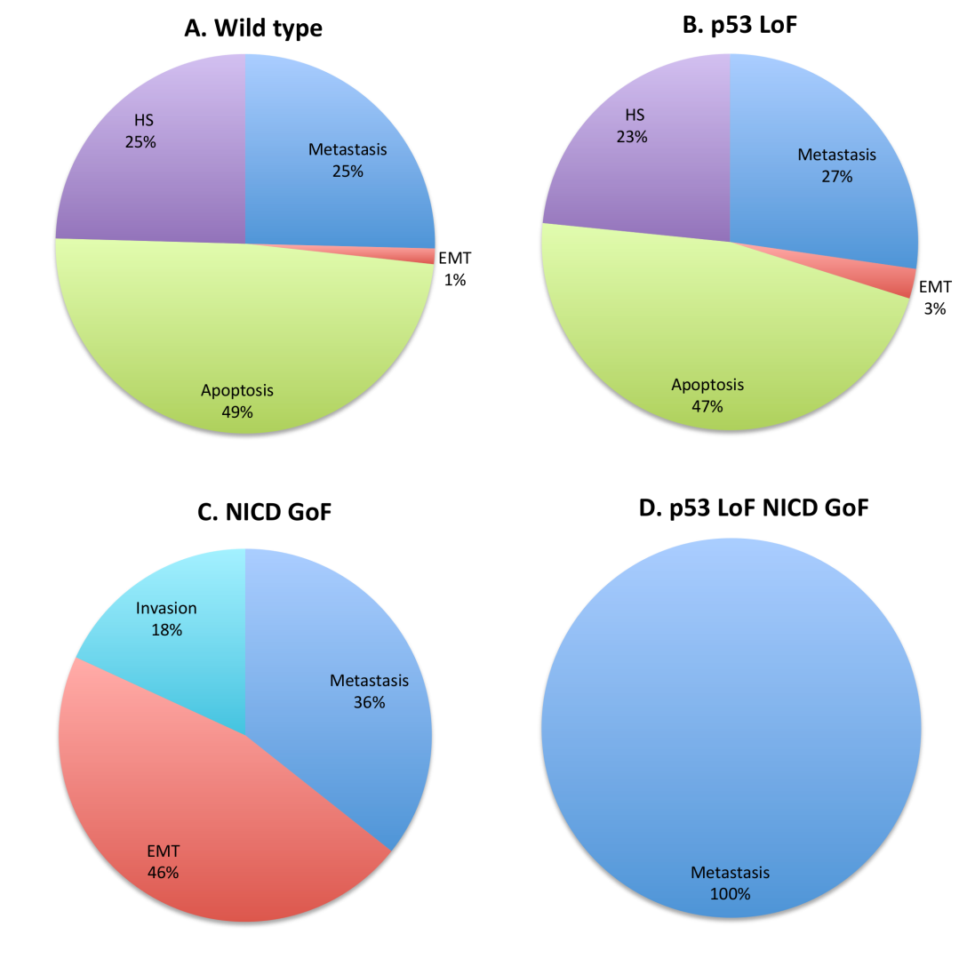
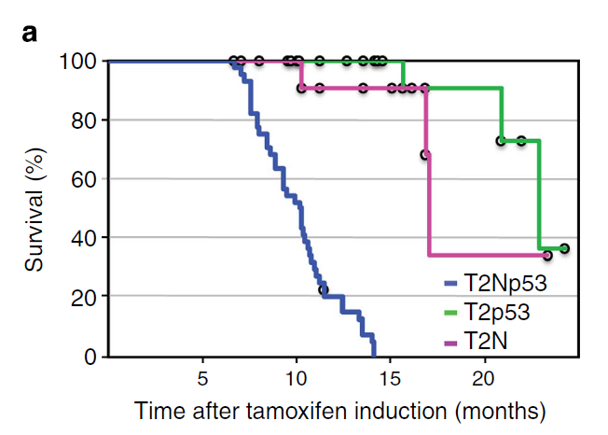
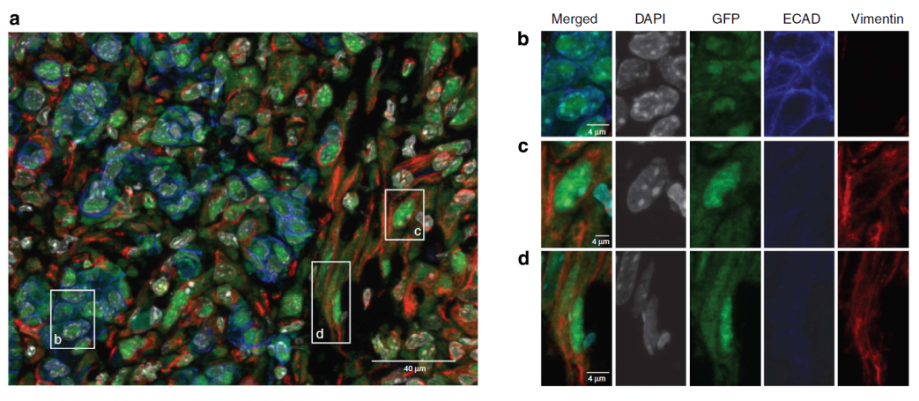
Mutants in MaBoSS
Model prediction
Mouse experiment
NICD++/p53–
Cohen et al, PLoS Comp Biol, 2015
*Chanrion et al. Nature Communications 2014
Cohen et al, PLoS Comp Biol, 2015
The model confirms the appearance of metastasis in the Notch++/p53-- double mutant

Slide 13
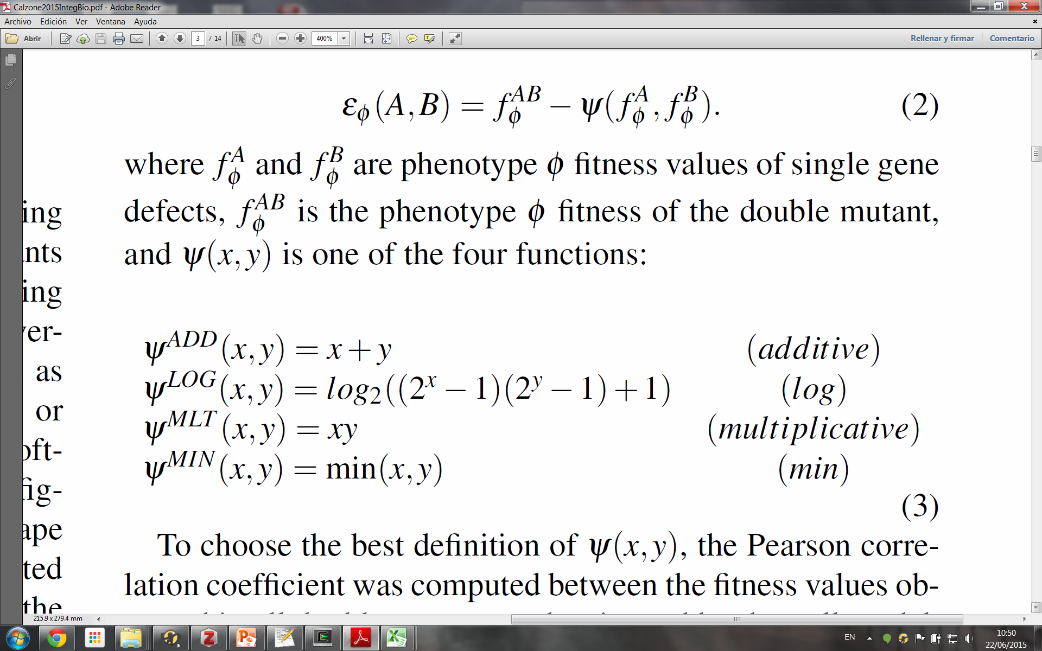
Can we predict genetic interactions?
masking interaction: the double mutant has no advantage over one of the single mutants
synergistic interaction: the double mutant is increasing or decreasing the probability of single mutants
Cohen et al, PLoS Comp Biol, 2015
Calzone et al, Integrative Biology, 2015
Notes:
The analysis is done with respect to a wild type phenotype
It is done in 3 steps:
we generate all mutants
we simulate MaBoSS to associate to each mutant a probability of phenotype (e.g. Metastasis)
we associate to double mutants, a type of genetic interactions depending on the computed epistasis value:
masking interaction: the double mutant has no advantage over one of the single mutants, or
synergistic interaction: the double mutant is increasing or decreasing the probability of single mutants

Slide 14
Generating genetic interactions
Generate-First Choose-Later strategy
Generating all mutants
Single, double, KO, OE
Run all MaBoSS instances
Gather a table with all results
Probabilities of all mutants across all stable states
Normalizing MaBoSS results
Mutants vs WT
Merge phenotypes
Analysing genetic interactions
Cohen et al, PLoS Comp Biol, 2015

Slide 15
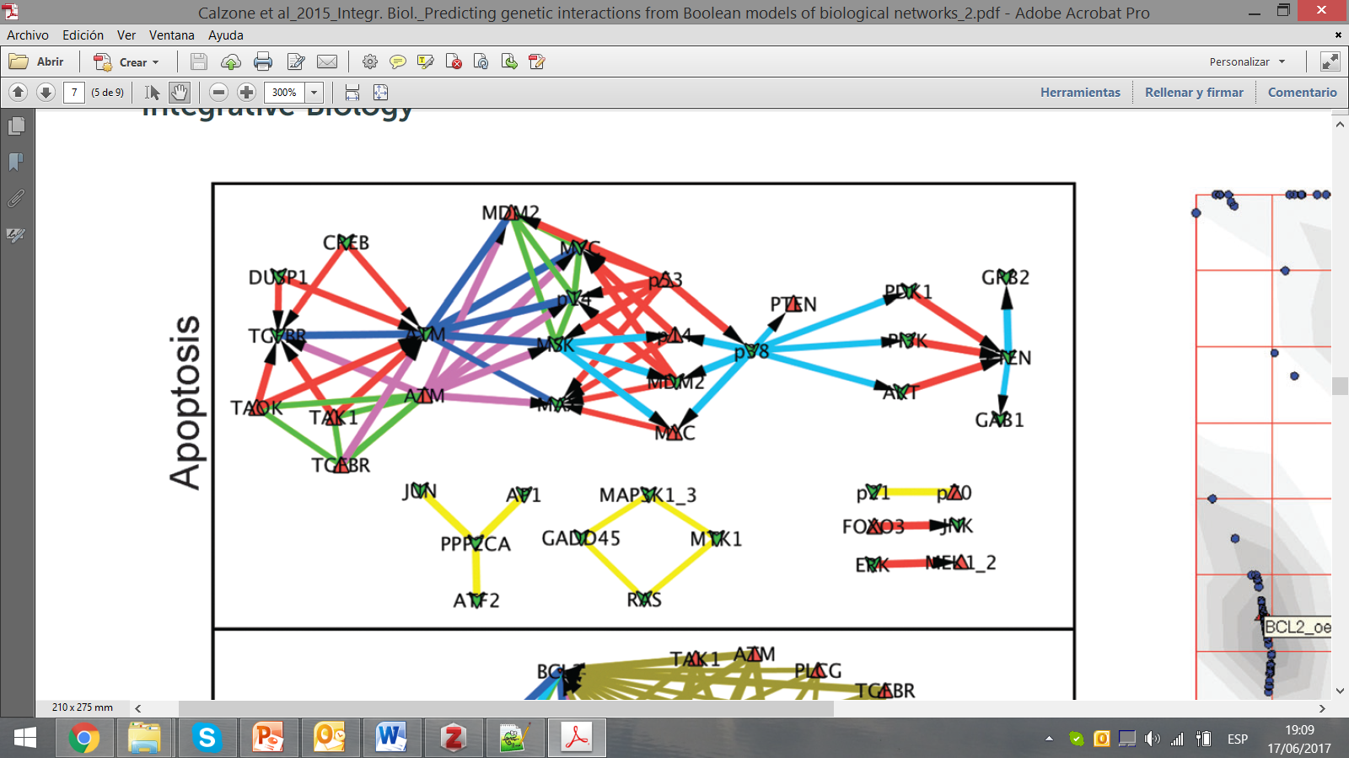
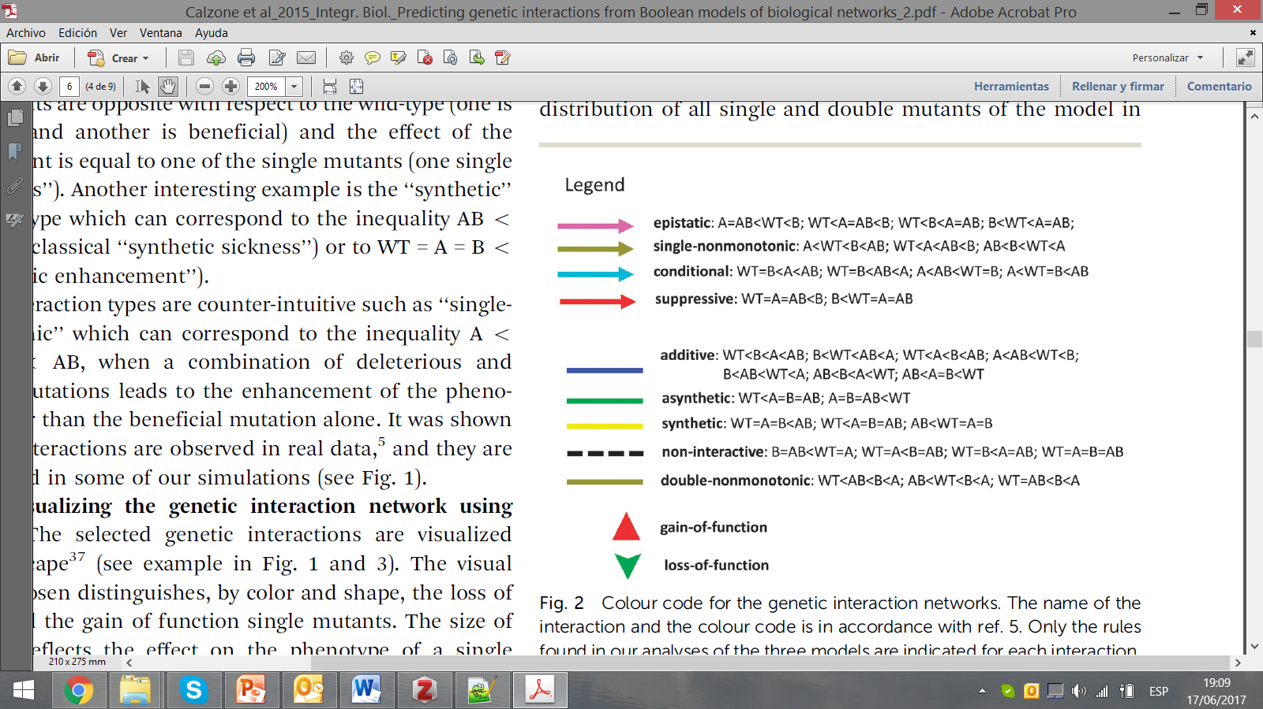
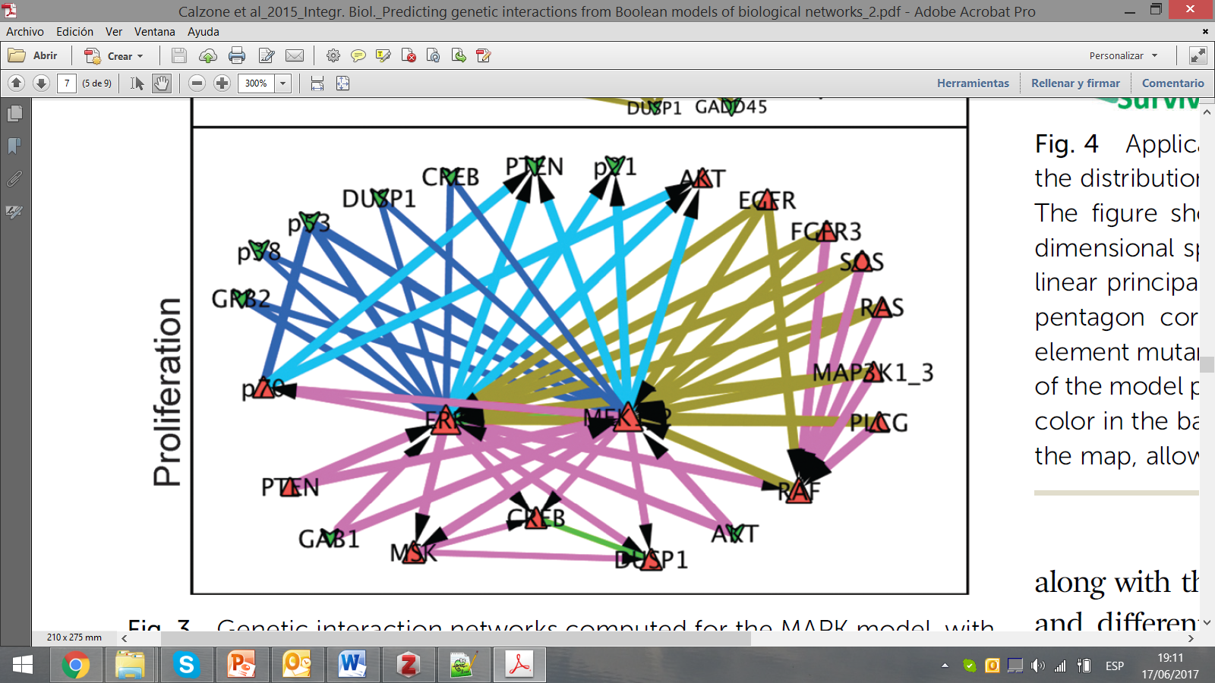
Types of genetic interactions
Calzone et al, Integrative Biology, 2015

Slide 16
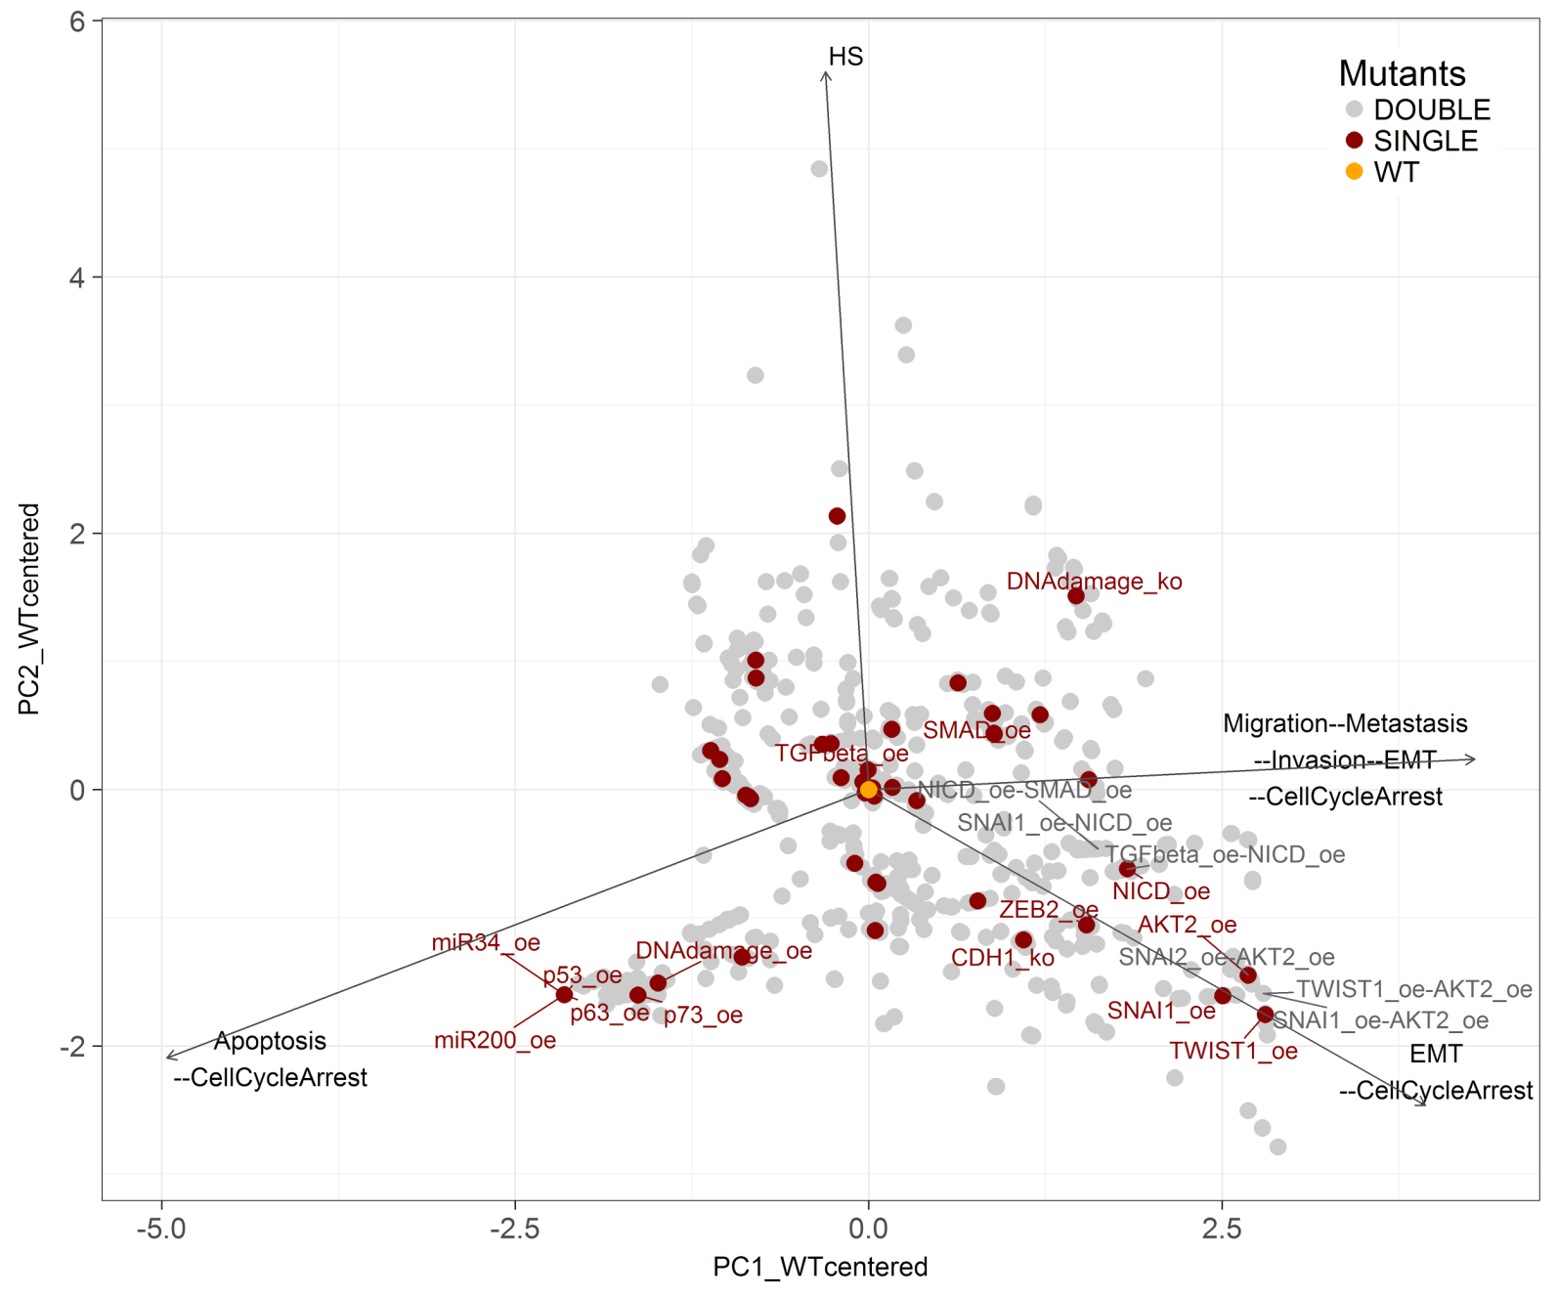
Studying mutants variability on phenotypes of interest

Slide 17
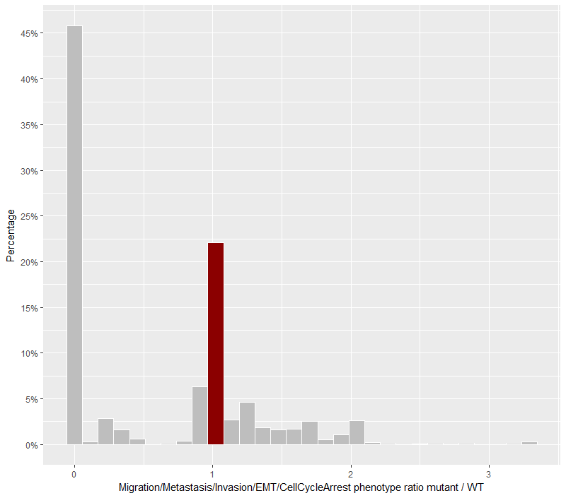
Robustness analysis of genetic interactions with respect to the phenotype probability
Does a mutant enhance or diminish the probability to reach Migration phenotype?
45.77% mutant combinations abolish the phenotype
KO of genes required for activation of Migration node, which is the node that requires more activated genes in the network
Additionally, we find overexpression of genes that are anti-migratory or pro-apoptotic
Lots of mutants annihilate
this phenotype
WT
Some mutants increase
this phenotype

Slide 18
Robustness of the model’s logical rules
Can we confirm that the proposed model is robust with respect to small changes?
Is there one model or a family of models that could be equivalent?
Can we identify the “weak spots” of the model?
Three tests were performed on logical rules
One operator in all rules was changed (f.i., from AND to OR)
Two operators in one rule were changed
One operator in two rules was changed
Question: how do these changes affect the probability to reach a phenotype?

Slide 19
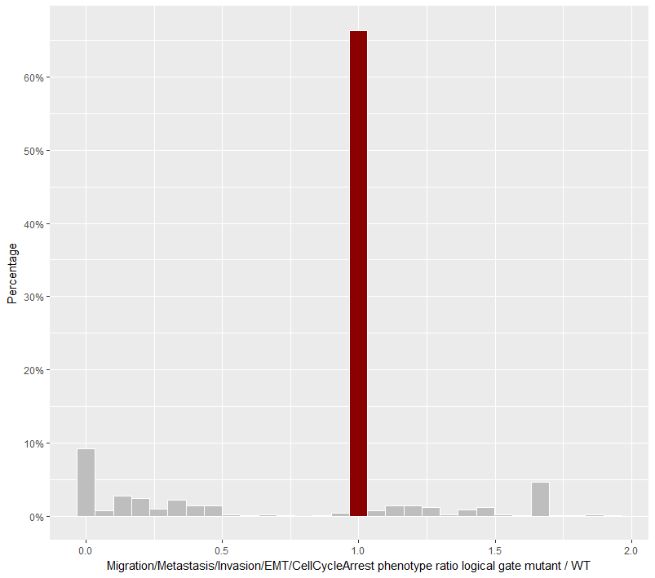
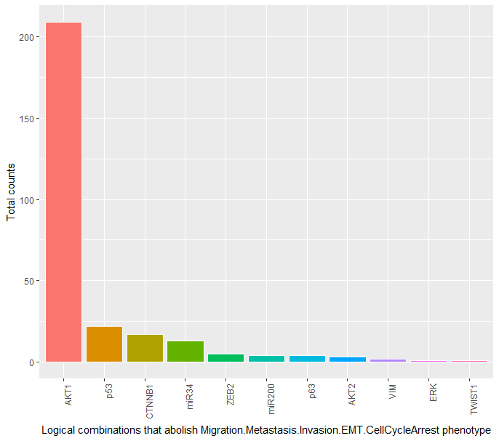
Robustness analysis of logical gates with respect to the phenotype probability
The model is quite robust with respect to all phenotypes
Metastasis is the least robust
The rules of some genes need to be more stringent: AKT1 and p53 in particular (anti-migratory)
WT

Slide 20

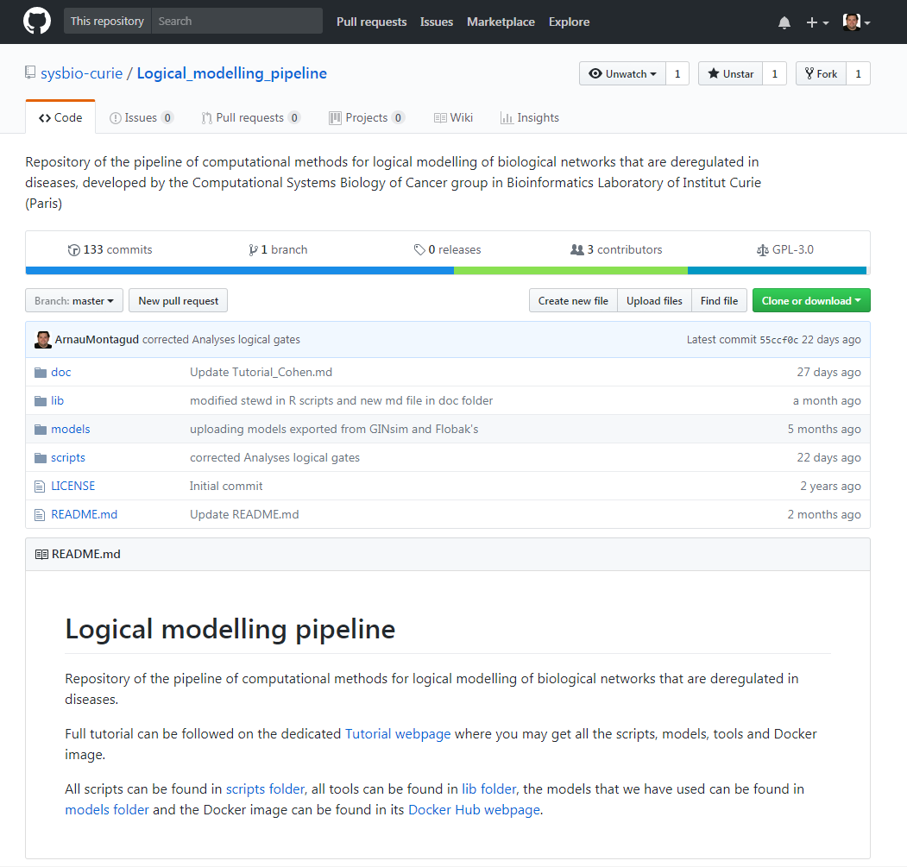
Logical modelling pipeline
https://github.com/sysbio-curie/Logical_modelling_pipeline
Extensive and comprehensive studies can be done with a validated model and tools on the field
Experimentally friendly hypotheses can come out of these studies
We aim to:
include other tools in the pipeline to get more insight from a model
be included in existing frameworks
show examples using other models in SBML format
provide a webpage with all scripts
as well as a Docker container
Notes:
CellNetOpt, BoolNet, Avatar, Cell Collective
Intro a github com a code dumping site, people can download, fork and propose modifications

